Slide 1
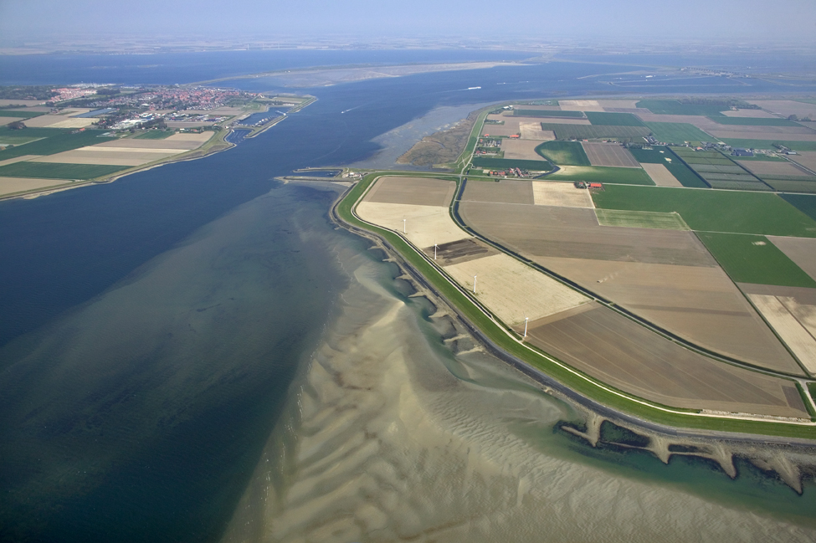


Introduction to Delft-FEWS

Slide 2
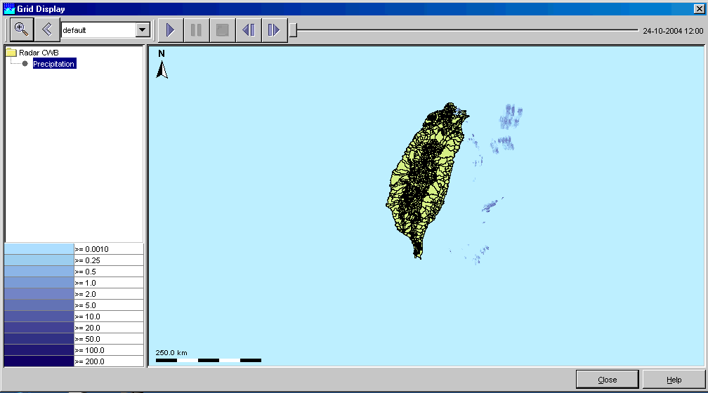
Deltares & (flood) forecasting
Floods, droughts & operational management
Water quality (incl. spills) and ecology (e.g. algae blooms)
Peat fire
Levee strength
Groundwater modelling
→ lead time
Detection
Warning
Response
Forecasting
Deltares
Simulation
Notes:
Delft-FEWS has been developed as a flood forecasting system, but in the mean time it is being used for several purposes

Slide 3
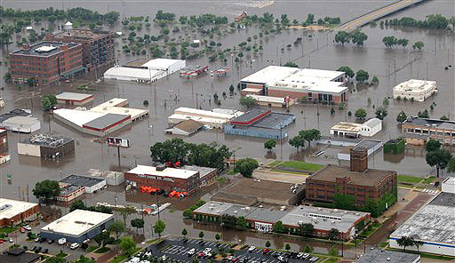
Forecasting… discharge at Lobith (Rhine)
data validation (errors/gaps)
data acquisition
warning &
dissemination
approving ‘a’ forecast
→ quality stamp
comparing output runs (graphs/tables)
running scenarios (manipulating input)
Detection
Warning
Response
Monitoring - precipitation
- waterlevels
Forecasting
collect ‘model’ data
run model(s)
water to river: Precipitation + rainfall-runoff model(s) + snow melt
water in river: Hydrodynamic model (river itself + tributaries)
Simulation
Notes:
Delft-FEWS has been developed as a flood forecasting system, but in the mean time it is being used for several purposes

Slide 4

Forecasting…
Aspects
many individual steps/operations
use different tools/techniques/software (telemetry, meteo, models)
time-consuming
availability of an ‘operator’
Results
(early) information and data about natural behaviour / events
action(s): warning/evacuation
To enable all this: Delft-FEWS

Slide 5
Not only forecasting…
Delft-FEWS also suitable as a:
Platform for (long term) storage of Water Information (WIS)
Waterboards systems
Platform for Optimization and Real Time Control
ISA HW (WSHD, NL)
BPA (Portland, USA)
Tam Tam (Almere)
Platform for running (long term) models/scenarios
Deltamodel
Platform for Automatic Data Conversion
DCM module

Slide 6
The Delft-FEWS Platform

Slide 7
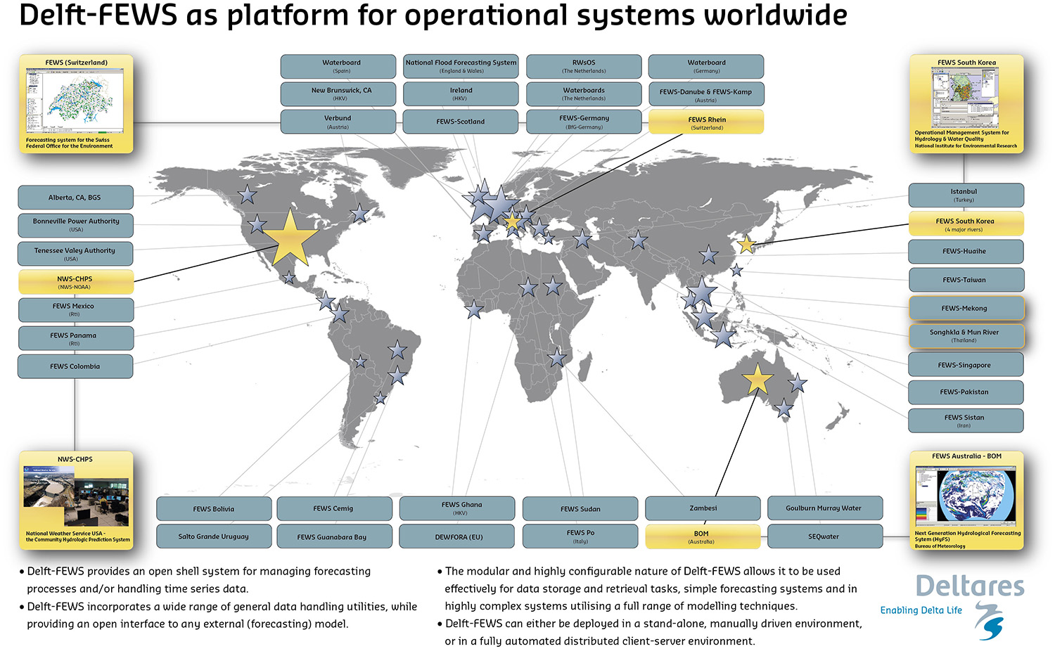
Delft-FEWS as platform for operational systems

Slide 8
Delft-FEWS (international)
Clients
Environment Agency (UK)
SEPA (Scotland)
NWS (USA)
BfG (D)
(regional) governments/agencies in Austria, Italy, Spain, Swiss, Taiwan, Singapore, Vietnam/Thailand, Australia etc.
In collaboration with:
Consultants (Royal Haskoning, JBA, Halcrow, etc.)

Slide 9
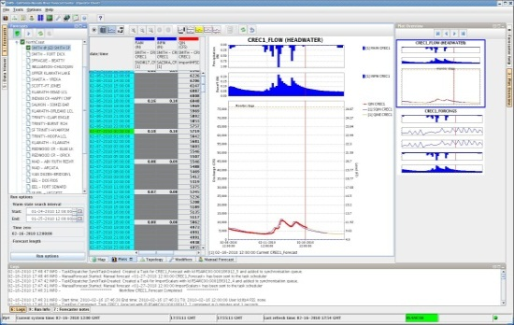
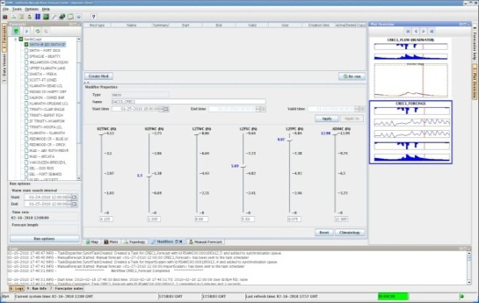
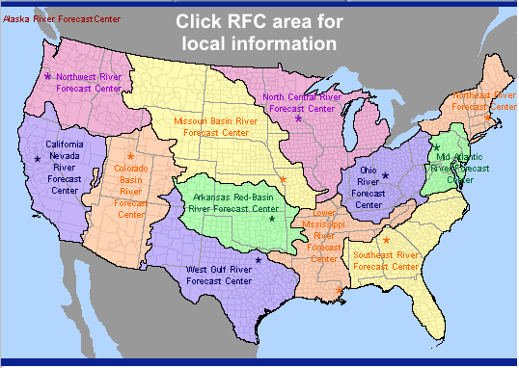
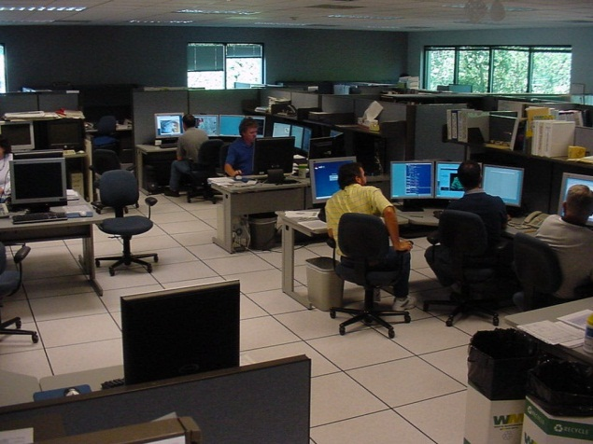
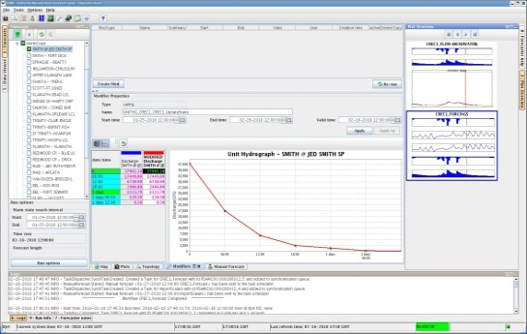
Community Hydrologic Prediction System (CHPS)
National River Forecasting System for…
National Oceanic & Atmospheric Administration (NOAA)
National Weather Service (NWS / OHD)
13 River Forecast Centers (RFC)
Currently: 7 RFC operational using FEWS
Notes:
Karel Heynert
Simone van Schijndel
Peter Gijsbers

Slide 10
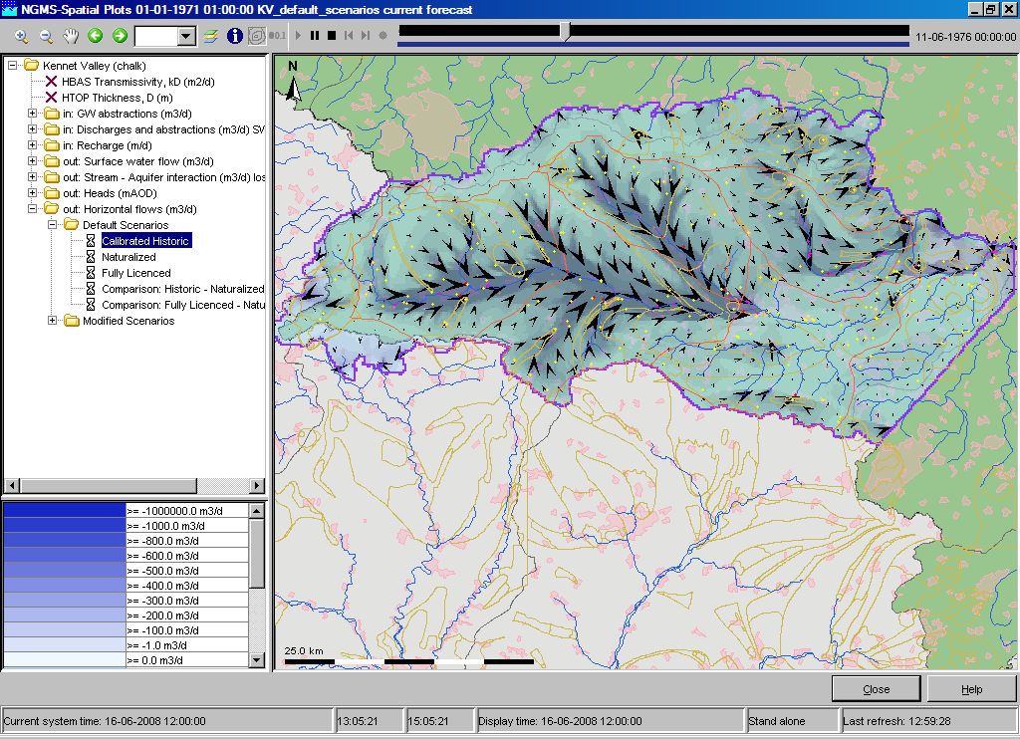
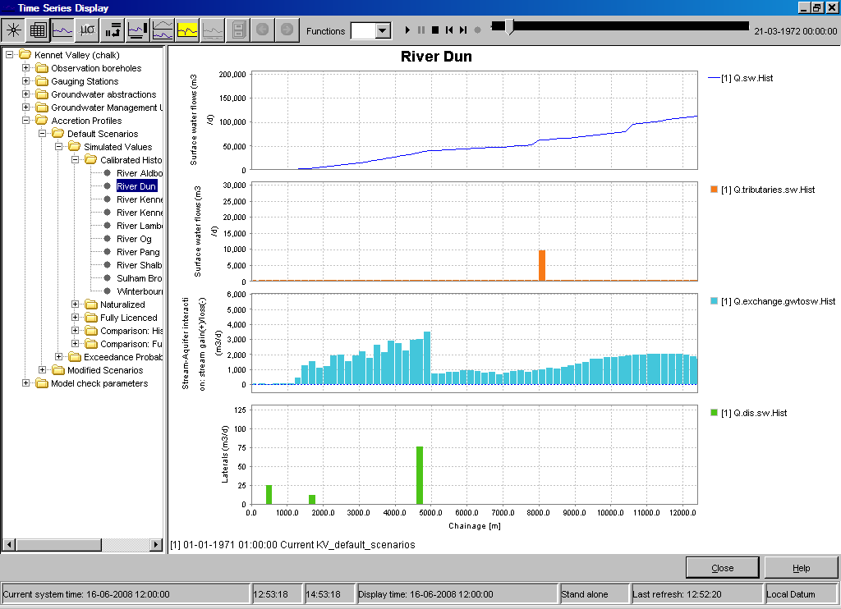
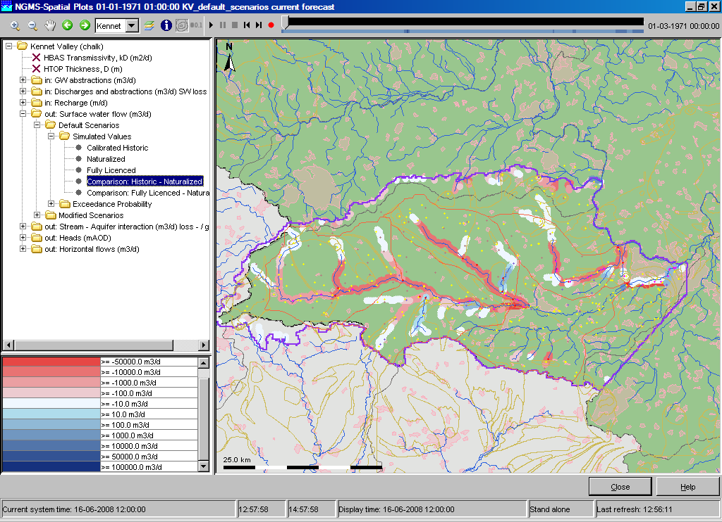
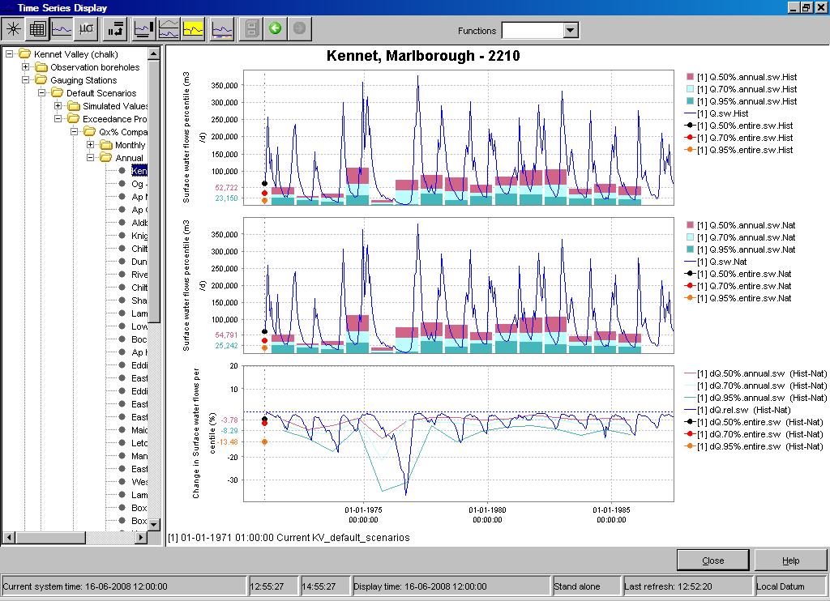
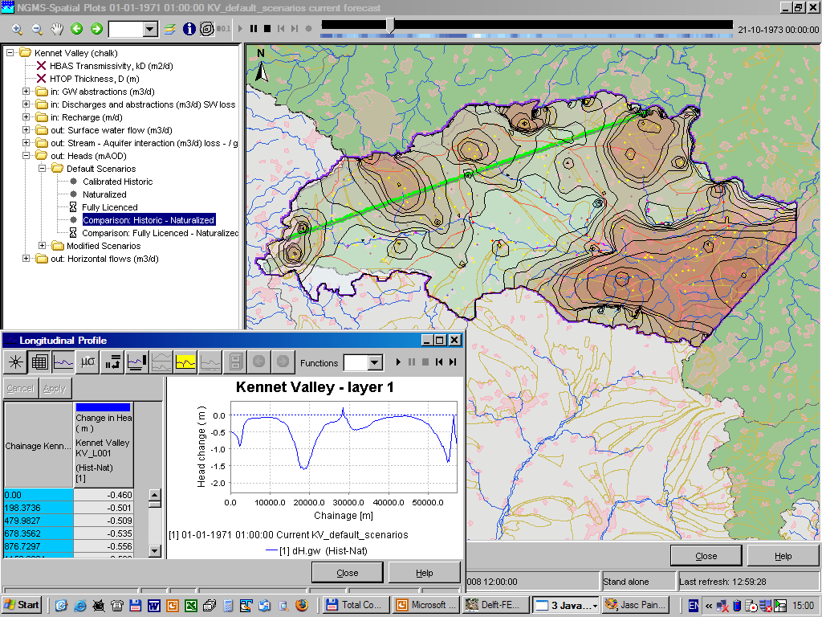
National Groundwater Modelling System for UK

Slide 11
Delft-FEWS (NL)
Clients
Municipalities
Waterboards
Ministry of PW & Watermanagement (Waterdienst)
In collaboration with:
NL Consultants (HKV, Nelen & Schuurmans, Hydrologic, DHV, …)
IBM (Flood Control 2015)
…

Slide 12
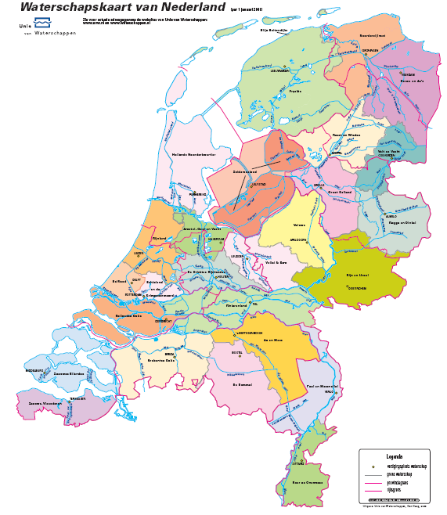
Delft-FEWS (NL)
BOS Noorderzijlvest
FEWS-Rivieren, FEWS-Meren,
FEWS Algen, FEWS Waterbeheer
FEWS IWP
Rijkswaterstaat
FEWS-LIZARD
Hollands Noorderkwartier
BOS Hunze & Aa’s
WIS Zuiderzeeland
WIS Velt & Vecht
FEWS-LIZARD Waternet
BOS Regge & Dinkel
AIM Veluwe
FEWS-LIZARD
Hollandse Delta
WIS Vallei en Eem
FEWS-LIZARD
Zeeuwse Eilanden
WIS HDSR
WIS Aa en Maas
WIS Peel en Maasvallei
WIS Roer en Overmaas
WIS & BOS De Dommel

Slide 13
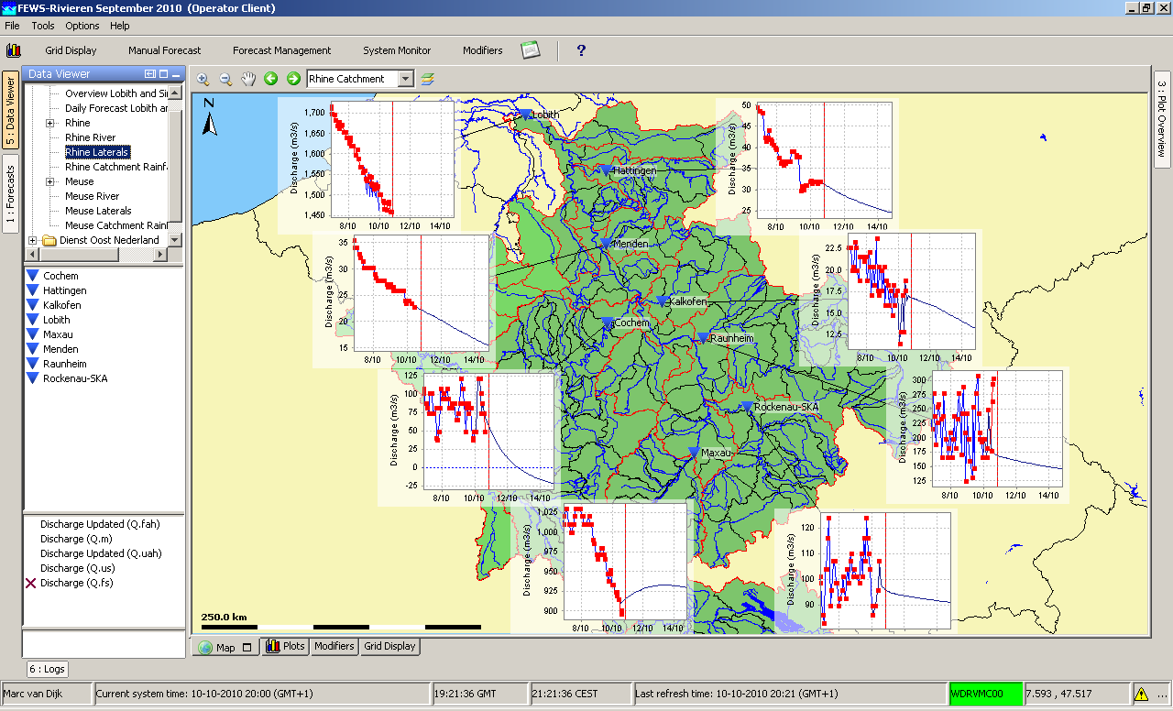
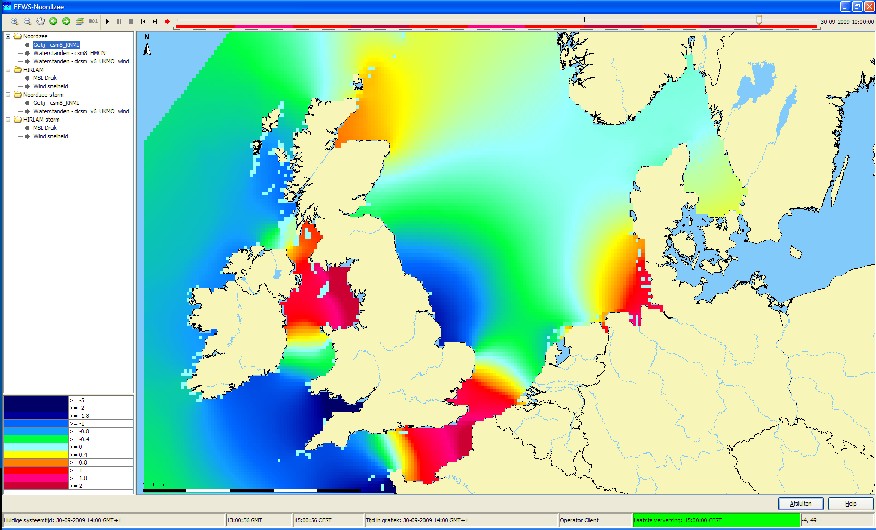
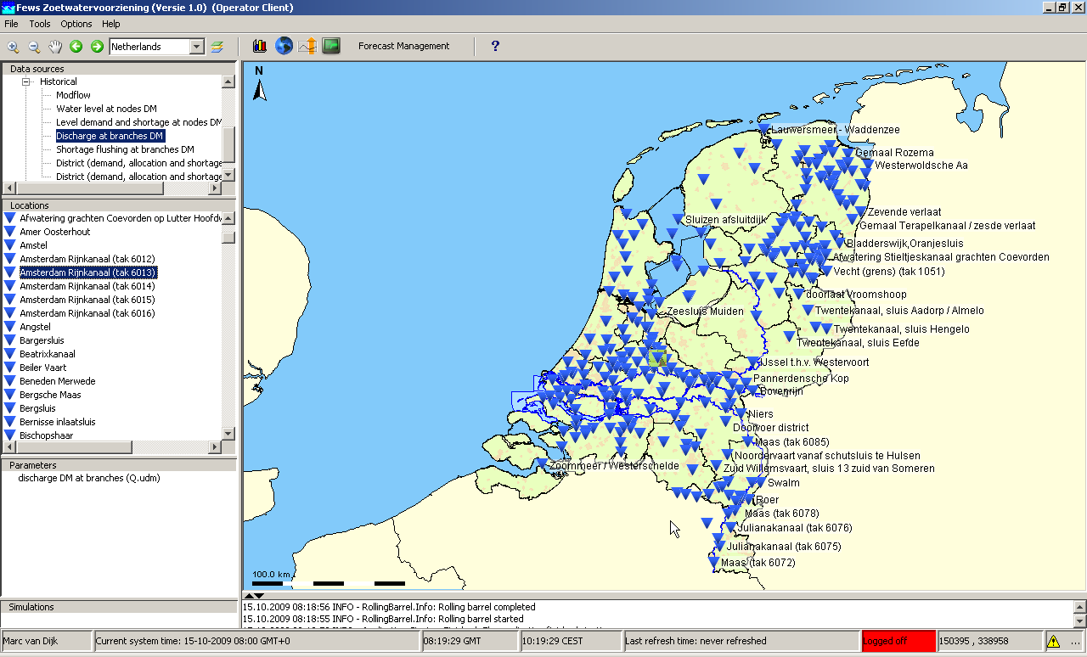
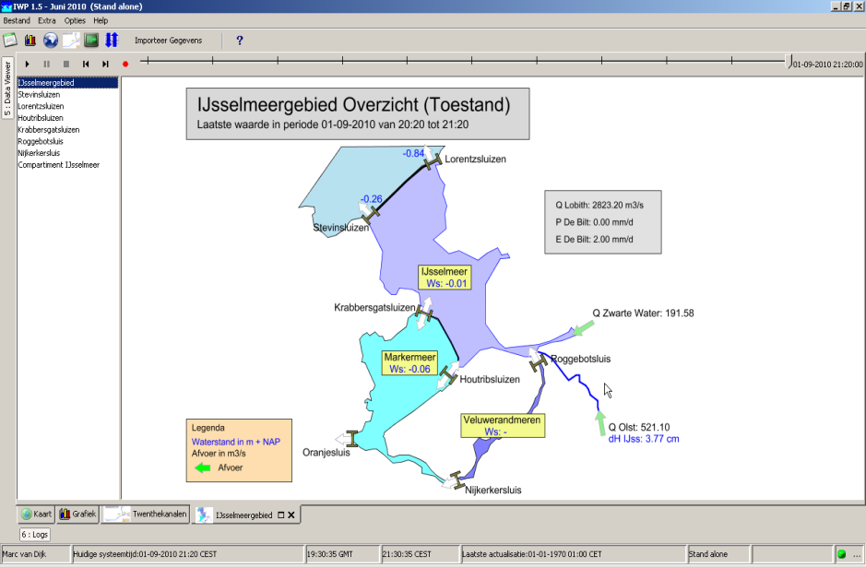
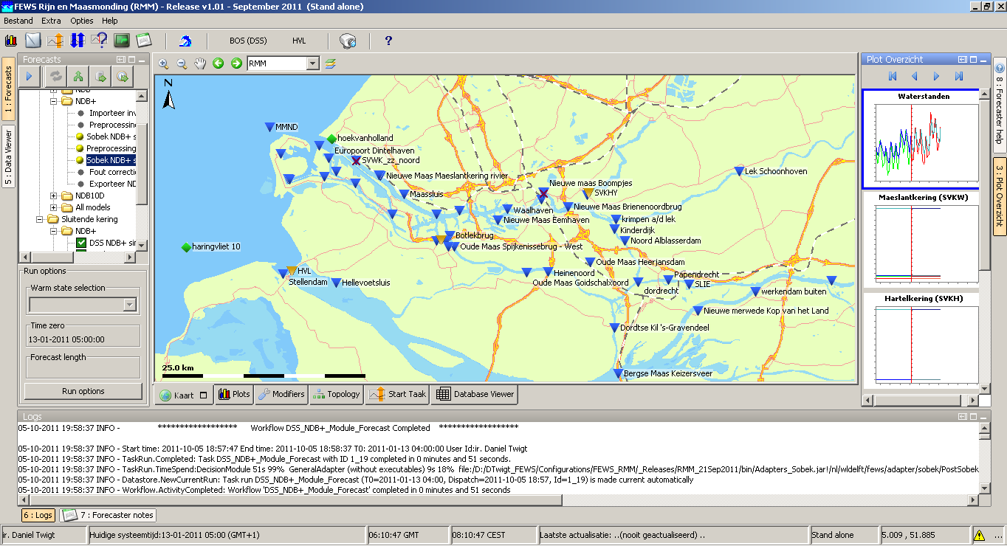
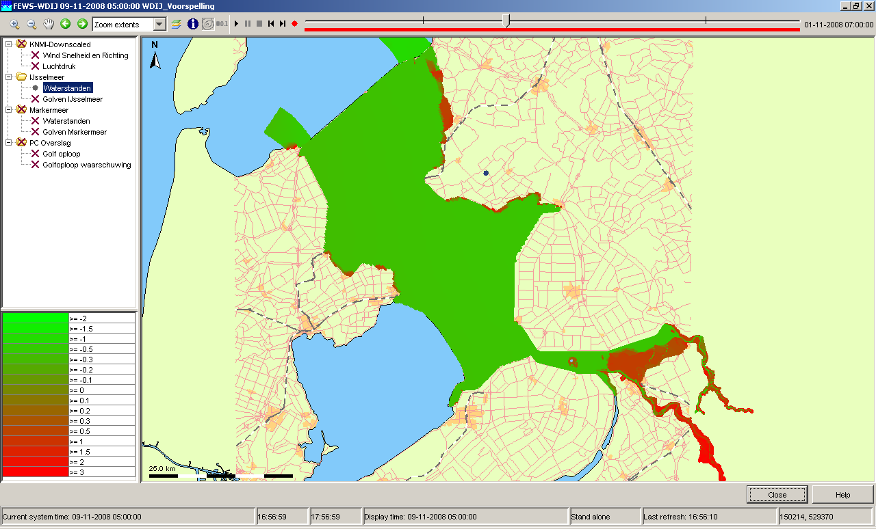
Delft-FEWS (NL) - Waterdienst applications
FEWS-Rivers (floods Rhine/Meuse)
FEWS North Sea (Water levels/Waves)
FEWS-W’Mgmnt (water distribution)
FEWS-Channels (Gauge Mgmnt)
FEWS-RMM (Delta-area, incl SSB)
FEWS-Lakes (Water levels Lake IJssel)

Slide 14
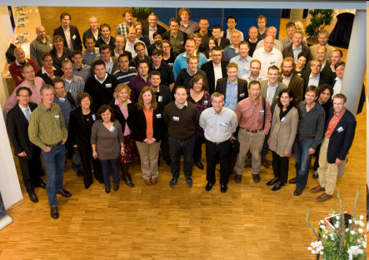
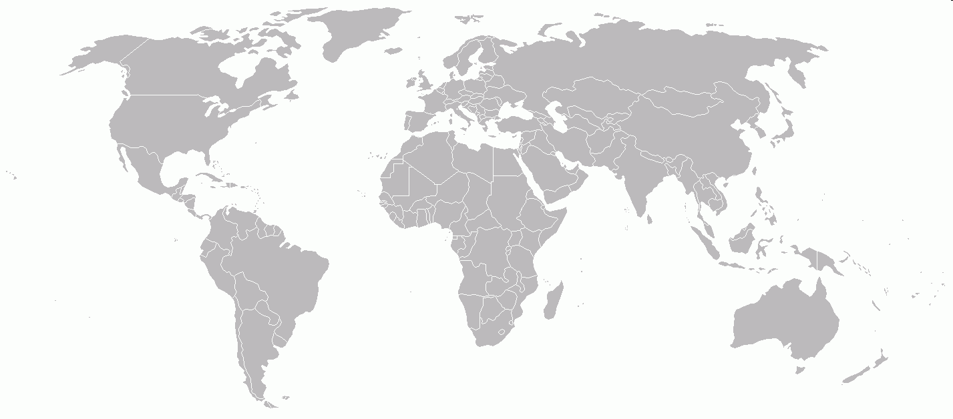
Delft-FEWS User Community
USA (NWS)
Canada
UK
Netherlands
Germany
Suisse
Italy
Austria
Spain
Singapore
Taiwan
Mekong River Commission
Australia
Sudan
Georgia
Azerbaijan
Zambezi
operational service
operational, status unknown
in development

Slide 15
Relation with Delft-FEWS User Community…
Longterm relation & commitment
Looking for the added value (science based development & consultancy)
Delft FEWS Policy…
Focus on implementation & development of forecasting sytems → taking responsibility in this process!
Software is carrier of knowlegde (free but no freeware) → high quality software required
Guarantee longterm support commitment
Financing further science & software development by user community (ad-hoc alliances initiated by Deltares) & own R&D
Notes:
Longterm relation & commitment with clients (support contracts)

Slide 16
Delft-FEWS
Open Shell Forecasting System

Slide 17
Delft-FEWS Philosophy
Generic information platform for data processing for flood and environmental forecasting systems
Links to all kinds of meteorological and observed data sources, such as
ground station monitoring devices, weather radar,
numerical weather models and
satellite images
Facilities to process such data in required formats
Links to a wide range of hydrological and hydraulic modelling systems
Easy to connect models and data sources, irrespective of their producers in order to avoid capital destruction of earlier investments by clients
Resilient system

Slide 18
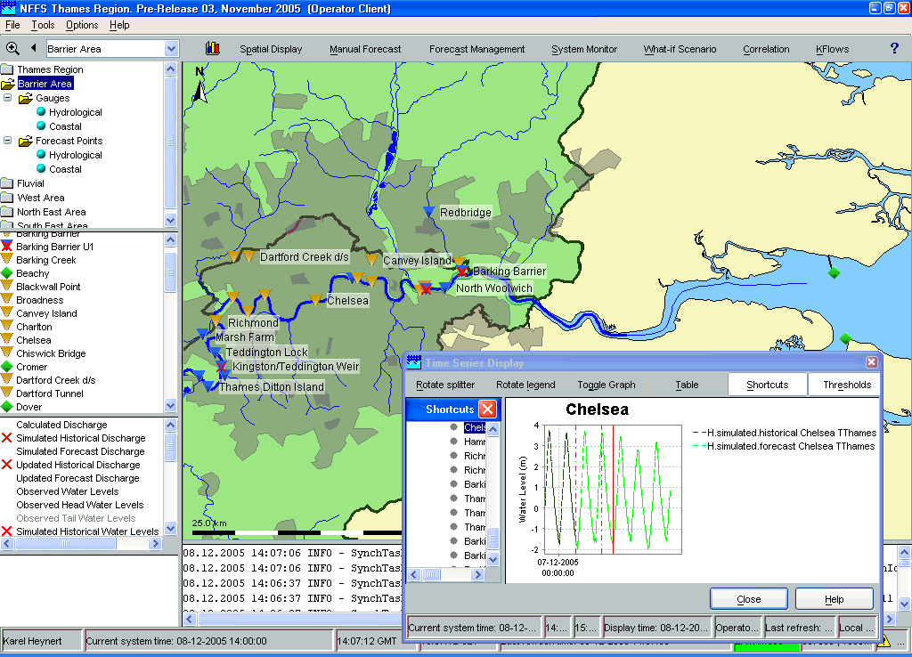
Delft-FEWS Philosophy
Toolbox for development of forecasting systems
Rapid implementation, scalable & flexible
Automatic / manual & stand alone
Fully ‘configurable’ by user
Binding dataflows + models
Real-Time

Slide 19
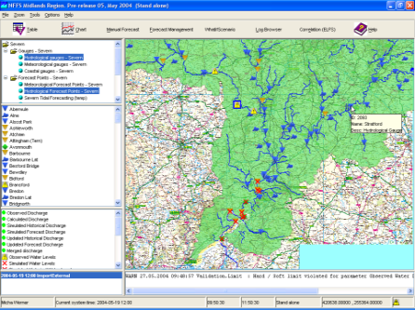
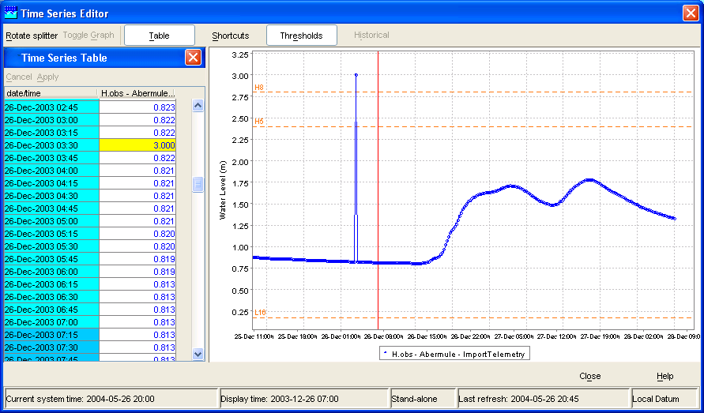
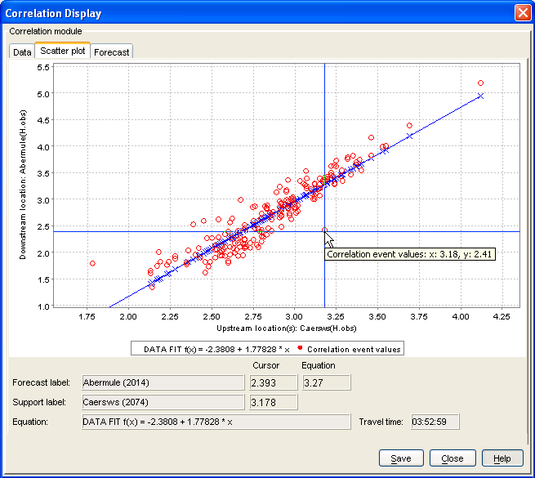
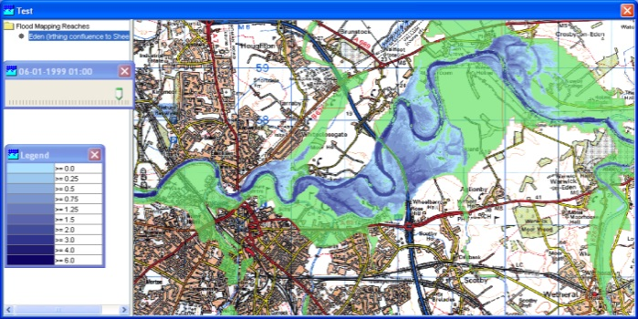
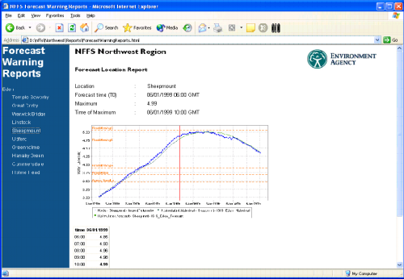
Delft-FEWS (concept)
data (feeds)
Delft-FEWS
import
validation
transformation / interpolation
data hierarchy
general adapter
export / report
administration (data, forecasts)
viewing (data, forecasts)
archiving
…
PI / NetCDF
import
models
export &
dessimination

Slide 20
Delft-FEWS Data (import formats)
Scalar
AHD
ArcWat DBF
BC2000
BFG
CSV
DINO
DiverMon
EA
EKSW
EKSW2005
EVN
Era15
FOC
FewsDatabase
hdf4
Hims
Hydris
HYMOSASCII
HYMOS
KNMI
KNMICSV
KNMIEPS
KNMIIRIS
KNMISYNOPS
Mosaic
Scalar (continued)
Msw
Mosm
NOOS
NTURAIN Import
NTUQUARTER Import
PI
PMDSynoptic
PMDTelemetric
RijnlandRTD
SSE
SHD
SHEF
SMA
SMAecmwf
Synop
Tmx
TmxCSV
TTRR
LUBW
WapdaTelemetric
Wiski
WSCCCsv
Wsd
DSS
Grid formats
ArcInfoAscii
BIL
BUFR
COSMO7_COR
DWD-LM
DWD-LM2
DWD-GME
GHD
GRIB
GRIB2
GRIBBASIC
GRIBCOSMO
hdfSoilMoisture
KNMI-HDF5
Landsat-HDF5
MATROOS NetCDF
NetCDF
Nimrod
NimrodMultipleDir
SwissRadar
GrayscaleImage
https://publicwiki.deltares.nl/display/FEWSDOC/Available+data+types

Slide 21
Delft-FEWS (concept)
data (feeds)
Delft-FEWS
import
validation
transformation / interpolation
data hierarchy
general adapter
export / report
administration (data, forecasts)
viewing (data, forecasts)
archiving
…
PI
import
models
export &
dessimination

Slide 22
Exchange of data: published interface
Delft-FEWS
published interface
General Adapter
input data
(pi xml)
output data
(pi xml)
Model Adapter
model
input data
model
output data
Model

Slide 23
Delft-FEWS External Models – Model Adapters
CEH Adapters (SNOWP, SNOW, PDM, KW, ARMA, TCM, HEC, GRID2GRID)
HR (ISIS)
PlanB Adapters (TRITON & PRTF)
DHI Adapters (Mike11, NAM)
Midlands Region (DODO, MCRM)
Southern Region (STF)
Northwest Region (NW TF – Common Adapter)
Wales (SW Overtopping module - Common Adapter)
SouthWest (Bruton/Holbeam Dam module – Common Adapter)
Deltares (RTC Tools, Delft3D, SOBEK, RIBASIM, HYMOS, Sacrament, SSARR)
SMHI (HBV)
University of Karlsruhe (PRMS)
JRC (Lisflood - PCRaster)
NWS (SNOW17, SAC-SMA, UNIT-HG, LAG/K, SARRROUTE, SSARRESV, RESSNGL, BASEFLOW, CHANLOSS, APICONT, CONSUSE, GLACIER, LAYCOEF, MUSKROUT, RSNELEV, SACSMA-HT, TATUM)
USACE (HEC-RAS, HEC-ResSim)
http://public.wldelft.nl/display/FEWSDOC/Models+linked+to+Delft-Fews

Slide 24
Delft-FEWS Software
Service Oriented Architecture
operating (business) aspects
system / platform ‘independent’
Java, XML & JMS
Oracle, PostgreSQL, MS SQLServer
Open Systems Approach…
Can be extended using plug-ins (Modules, Displays)
Transparent configuration using XML file format
External modules can be integrated using XML as exchange format
Provides access to time-dependent data via JDBC, WebServices

Slide 25
Delft-FEWS settings
Stand alone
all activities are done on (your) local machine (desktop/laptop)
Client-Server
clients log on to ‘central backend’
calculations are done on designated machines/servers
data ‘downloaded’ to local machine (laptop/desktop)
activities scheduled with fixed intervals (import, forecasts)
manually invoked activities from clients → queue

Slide 26
Delft-FEWS system overview (stand-alone)
stand alone

Slide 27
Delft-FEWS System overview (client-server)
server
client
forecasting shell(s)
configuration
manager
FSS
CM
master controller
operator client(s)
MC
OC
admin interface
central database
AI
CDB
Notes:
Client-Server
clients log on to ‘central backend’
calculations are done on designated machines/servers
data ‘downloaded’ to local machine (laptop/desktop)
activities scheduled with fixed intervals (import, forecasts)
manually invoked activities from clients → queue

Slide 28
Delft-FEWS System overview (client-server)
server
client
executing workflows
configuration
management
FSS
CM
= synchronisation
task dispatcher
user management
user
MC
OC
system
management +
scheduling tasks
storage of all data
AI
CDB
Notes:
Client-Server
clients log on to ‘central backend’
calculations are done on designated machines/servers
data ‘downloaded’ to local machine (laptop/desktop)
activities scheduled with fixed intervals (import, forecasts)
manually invoked activities from clients → queue

Slide 29
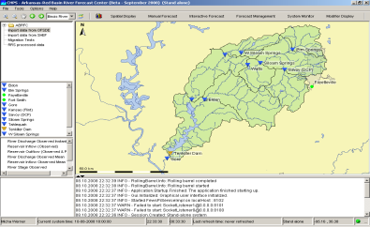
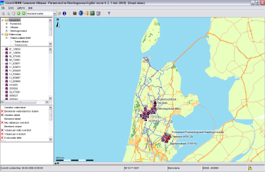
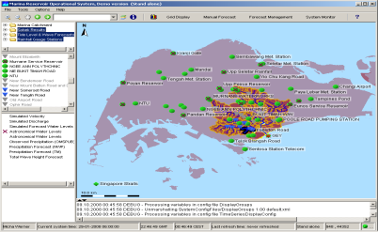
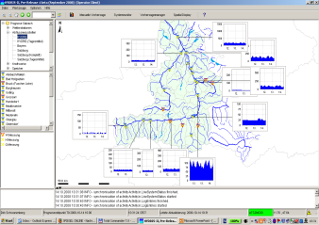
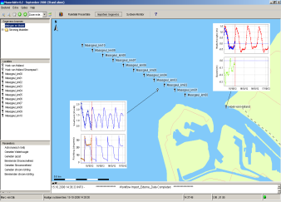
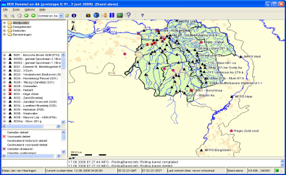
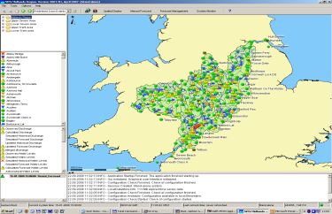
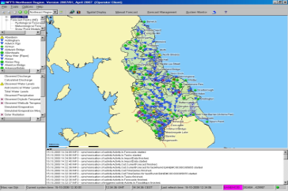
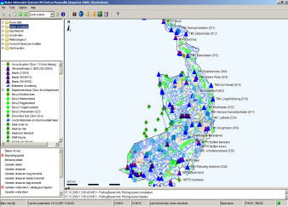
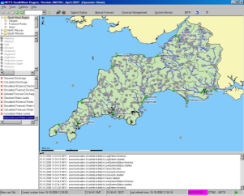
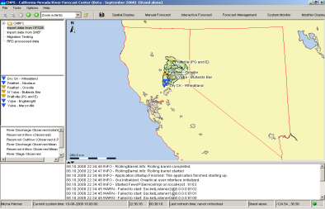
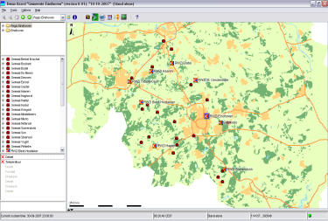
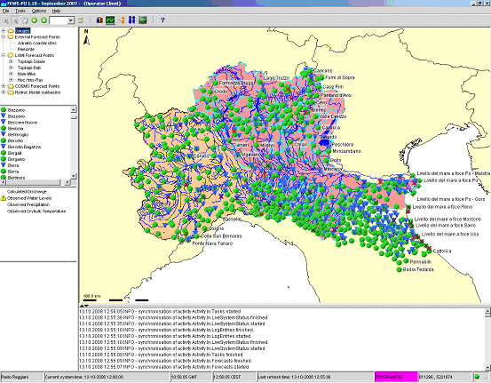
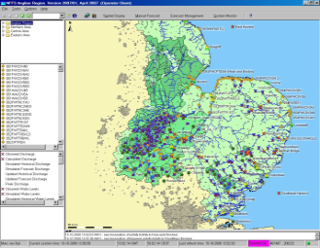
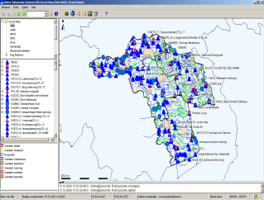
Demonstration
Operator Client: FEWS Noordzee – live/current data

Slide 30
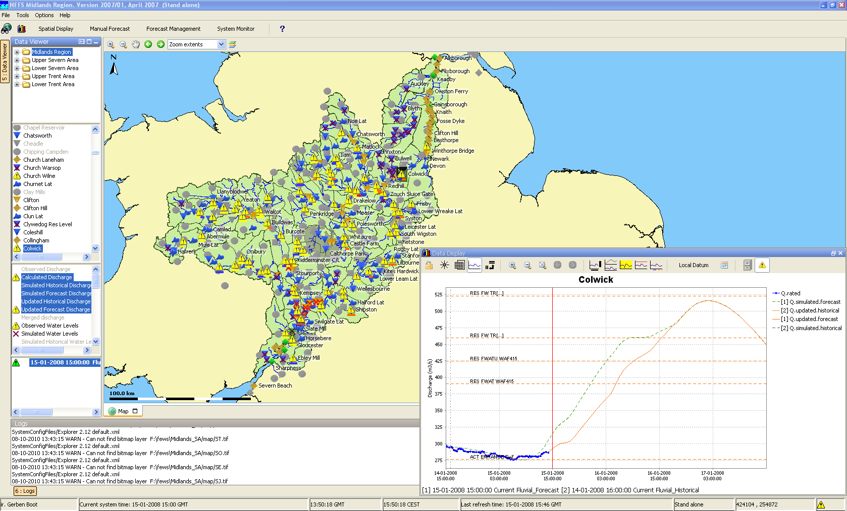
Delft-FEWS GUI
dropdown menus
button bar
map display
Filters
Locations
Parameters
Open forecasts
status bar
log viewer

